Slide 1

Department of Electronics and Telecommunication
B.E. Project Report Stage I
E&TC(2025-26)
46. Pardeshi Siddharth Manoj
45. Kulkarni Saideep Rahul
43. Kanawade Mahesh Nitin
47. Kale Tejas Gahininath
Guide : Prof. Mr. M. R. Gaikar & Dr. S. M. Gulhane

Slide 2
Department of Electronics and Telecommunication
BE E&TC Project (2025-26)
Area of Work: Embedded Systems, AI etc.
Title : ‘Context-Aware Audio Guidance System for the Visually Impaired’

Slide 3
Introduction:
It’s a wearable smart-glasses system designed to act as “eyes” for visually impaired people. The glasses will have a camera that continuously captures the surroundings and detects obstacles or objects in real time.
A Raspberry Pi will serve as the main processing unit. Based on what the camera detects and how far obstacles are, the system will generate contextual voice guidance through earphones.
Some hardware (like the Raspberry Pi and power supply) will be worn separately to keep the glasses lightweight. The goal is to make a fast, reliable, and comfortable assistive device that helps the visually impaired walk independently in real-world environments.

Slide 4
Problem Statement: Visually impaired individuals face challenges in detecting obstacles limiting their mobility and safety.
Our Solution: A wearable smart glasses system that acts as an intelligent visual guide.
Key Features:
Real time object detection using AI
Distance & direction Estimation
Clear audio feedback
Dual modes: Automatic & Manual
Goal: To make a fast, reliable, and comfortable assistive device.

Slide 5
Functional Requirements:
Real-time object & distance detection.
Audio feedback with ≤300 ms delay.
Multi-object handling and battery alerts.
Non-functional Requirements:
≥10 FPS detection, 70 % accuracy (mAP).
Weight < 500 g, runtime > 6 hours.
Safe, offline, user-friendly.
Technology Stack:
Hardware:
Core: Raspberry Pi 4 (8GB)
Vision: Raspberry Pi Camera Module 3
Sensing: LiDAR Sensor
Audio: Wired Headphones
Power: 10,000mAh Power Bank
Software:
OS & Language: Raspberry Pi OS & Python
AI Model: YOLOv8n (Optimized for speed)
Libraries: OpenCV, TensorFlow Lite, pyttsx3 (for voice)

Slide 6
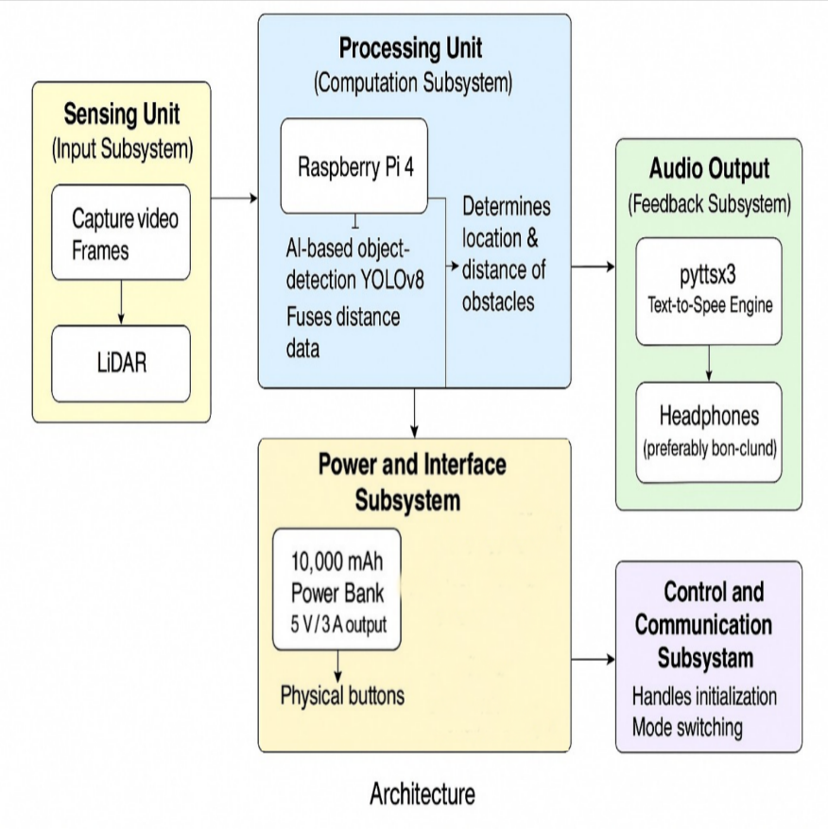
System Architecture:
1. Sensing Unit: Camera and LiDAR capture visual and distance data from the environment.
2. Processing Unit: Raspberry Pi 4 runs the YOLOv8n model, fuses sensor data, and generates contextual decisions.
3. Audio Output Unit: pyttsx3 or pre-recorded audio provides spoken alerts through bone-conduction earphones.
4. Power & Interface Unit: Powered by a 10,000 mAh battery; includes basic control buttons.
5. Control & Communication Unit: Handles data logging, power monitoring, and optional Bluetooth/serial communication.

Slide 7
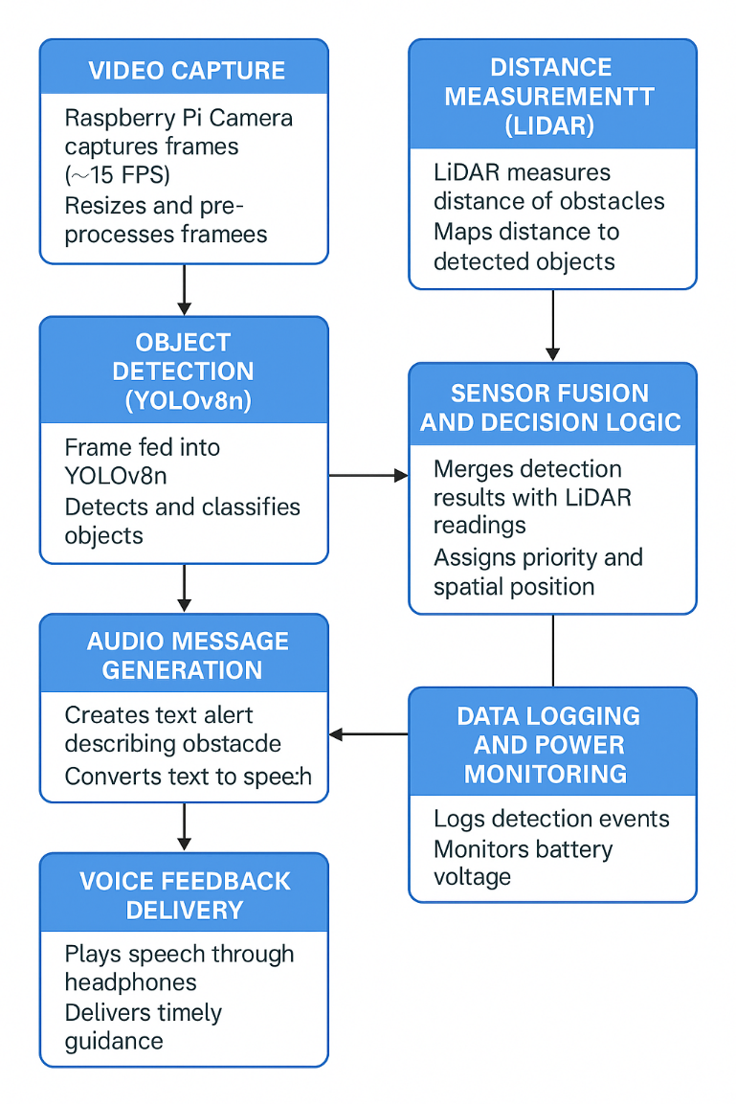
System Workflow / Flowchart:
1. Video Capture: The Raspberry Pi Camera continuously records frames (≈15 FPS) and resizes them to match YOLOv8n input dimensions (320×320 px).
2. Object Detection: Each frame is processed by the YOLOv8n model to detect & classify obstacles such as people, vehicles, stairs in real time.
3. Distance Measurement: The LiDAR sensor measures the distance of nearby objects and sends data to the Raspberry Pi via I²C or UART.
4. Sensor Fusion & Decision Logic: Camera and LiDAR data are combined to identify obstacle position (Left, Center, Right) and distance level (near, far). The system prioritizes the closest obstacle for alerting.
5. Audio Message Generation: Based on detected data, a short contextual phrase (e.g., “Person two meters ahead”) is created using pyttsx3 or pre-recorded WAV files.
6. Voice Feedback Delivery: The message is played instantly through bone-conduction earphones, ensuring the user can still hear ambient sounds.
7. Data Logging & Battery Monitoring: All detections and timestamps are saved for evaluation, while battery level is monitored to issue low-power voice alerts.

Slide 8
Results:
Modules tested: Vision + Audio (LiDAR pending).
YOLOv8n: 7–10 FPS @ 320×320; mAP ≈ 0.71.
Latency: Detection→Speech ≈ 250–320 ms.
Audio Output: pyttsx3 (200–300 ms) / WAV (25–40 ms).
Runtime: ≈ 6 hours on 10 000 mAh battery.
Fully functional, low-latency, offline prototype achieved.

Slide 9
Conclusions:
Stage 1 of the Context-Aware Audio Guidance System successfully demonstrated the core functionality of the project using the camera and audio modules.
The Raspberry Pi 4 efficiently handled real-time image capture, object detection using YOLOv8n, and speech generation through the pyttsx3 engine, proving that the system can operate fully offline with acceptable latency.
The prototype achieved stable performance, low processing delay, and reliable audio output, establishing the foundation for integrating distance sensing and sensor fusion in the next phase.
Overall, the system proved technically feasible, user-friendly, and capable of providing meaningful real-time guidance to visually impaired users.

Slide 10
Next Steps & Final Goal:
Next Steps:
Integrate Hardware: Connect sensors and buttons to the Pi.
Assemble Prototype: Mount components onto the glasses frame.
Real-World Testing: Test and refine the system in different environments.
Final Goal:
To deliver a functional, wearable prototype that significantly improves safety and mobility for the visually impaired.

Slide 11
References:
[1] W. Elmannai and K. Elleithy, “Sensor-Based Assistive Devices for Visually-Impaired People: Current Status, Challenges, and Future Directions,” Sensors, vol. 17, no. 3, pp. 1–37, 2017.
[2] X. Zhang, Y. Liu, and P. Wang, “Advancements in Smart Wearable Mobility Aids for Visual Impairments: A Bibliometric Narrative Review,” Sensors, vol. 24, no. 2, pp. 1–20, 2024.
[3] A. Lavric, C. Popa, and M. Ursachi, “A Comprehensive Survey on Emerging Assistive Technologies for Visually Impaired Persons,” Sensors, vol. 24, no. 8, pp. 1–18, 2024.
[4] M. Brilli, A. Mazzocchi, and L. Frosini, “AIris: An AI-Powered Wearable Assistive Device for the Visually Impaired,” arXiv preprint arXiv:2401.10256, 2024.
[5] G. Măgurean and L. Beșoiu, “Edge Inference Assistance System for Visually Impaired Individuals on Running Tracks,” Results in Engineering, vol. 27, p. 106729, 2025.
[6] A. Bouteraa, H. Regaieg, and M. Feki, “Smart Real-Time Wearable Navigation Support System for BVIP,” Alexandria Engineering Journal, vol. 62, pp. 223–235, 2023.
[7] H. Liu and Q. Feng, “Wireless Embedded Wearable Haptic Assistance Navigation Device Based on Networked Technology for the Visually Impaired,” Computers & Electrical Engineering, vol. 107, p. 110540, 2025.
[8] A. Dernayka, M. Balle, and B. Marc, “Tom Pouce III, an Electronic White Cane for Blind People,” Sensors, vol. 21, no. 12, pp. 1–16, 2021.
[9] P. Mungdee, T. Chaimankong, and N. Chatwiriya, “Low-Cost Smart Cane with Pathway Surface Detection and YOLO Object Detection,” Information, vol. 16, no. 1, pp. 1–15, 2025.
[10] M. Islam, T. Akter, and S. Rahman, “Deep Learning-Based Object Detection and Surrounding Environment Description for Visually Impaired People,” Heliyon, vol. 9, no. 6, p. e16924, 2023.

Slide 12
References:
[11] R. Baldovino, A. Umandap, and J. Uy, “A Visual Aid System Using Image Processing and Deep Learning with Audio Haptic Feedback for the Blind and Visually Impaired,” Procedia Computer Science, vol. 246, pp. 2974–2983, 2024.
[12] E. Yilmaz, F. Sen, and M. Kocak, “Evaluating YOLOv4 and YOLOv5 for Enhanced Object Detection in UAV-Based Surveillance,” Processes, vol. 11, no. 5, pp. 1–13, 2023.
[13] X. Liu, J. Li, and K. Wu, “EdgeYOLO: An Edge-Real-Time Object Detector,” Computer Vision and Image Understanding, vol. 241, p. 103670, 2023.
[14] D. Surantha and A. Sutisna, “Optimization of Deep Learning Models for Edge Devices: Quantization and Pruning Techniques,” ICT Express, vol. 11, no. 1, pp. 45–53, 2025.
[15] L. Garcia, J. Lopes, and P. Carvalho, “Wearable Obstacle Detection System Fully Integrated to Textile Structures,” Sensors and Actuators A: Physical, vol. 179, pp. 84–92, 2012.
[16] S. Pundlik, R. Tomasi, and B. Luo, “Home-Use Evaluation of a Wearable Collision Warning Device for Individuals with Severe Vision Impairments,” J. Rehabil. Assist. Technol. Eng., vol. 8, pp. 1–9, 2021.
[17] A. Camacho, R. Reinoso, and D. Rodriguez, “Integrating an Intuitive Tactical Navigation Solution to Enable Situational Awareness for People with Visual Disabilities,” Applied Ergonomics, vol. 129, p. 104576, 2025.
[18] R. Dos Santos, F. Silva, and T. Campos, “NavWear: Design and Evaluation of a Wearable Device for Obstacle Detection for Blind and Visually Impaired People,” Disability and Rehabilitation: Assistive Technology, vol. 20, no. 6, pp. 1–12, 2025.
[19] W. Seiple, J. Szlyk, and H. Tang, “Performance on Activities of Daily Living and User Experience When Using AI by Individuals with Vision Impairment,” Translational Vision Science and Technology, vol. 14, no. 2, pp. 12–25, 2025.

Slide 13
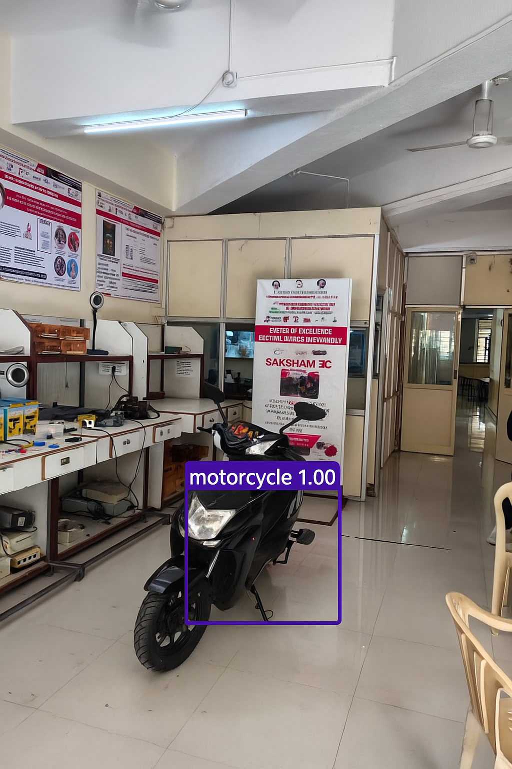
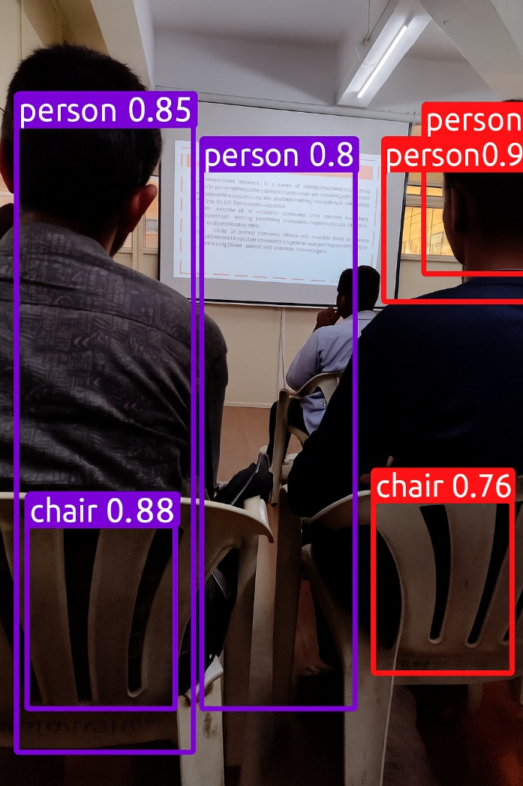
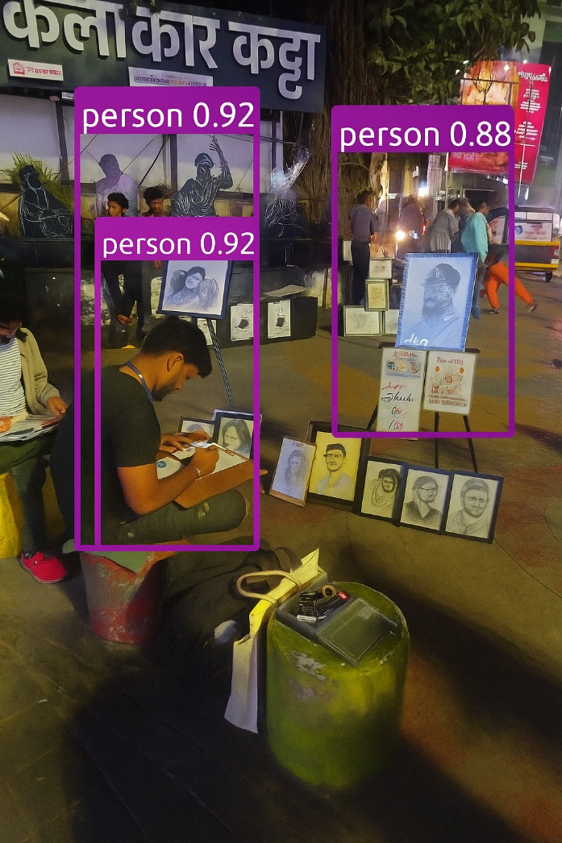

Slide 14
